Slide 1
Using Quotations in Your Writing

Slide 2
Notes Directions
Only write down the information from this presentation that is in GREEN font
USE THE NOTES TO HELP WITH YOUR WOD!

Slide 3
Quotations provide evidence to support your claims & assertions

Slide 4
The Basic Rules
Tied to your sentences and your ideas
  Never suddenly appears out of nowhere.
Must be introduced
Never use a quotation as a complete sentence by itself.

Slide 5
Incorrect
Scout describes Walter Cunningham. “Walter looked as if he had been raised on fish food: his eyes, as blues as Dill Harris’s, were red rimmed and watery” (23).”

Slide 6
Correct
  Scout says, “Walter looked as if he had been raised on fish food: his eyes, as blue as Dill Harris’s were red-rimmed and watery” (23).

Slide 7
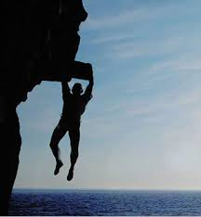
1. Discuss your quotations
Do not use a quote and then leave the words hanging as if they were self-explanatory. Tie it to your claims / assertions.

Slide 8
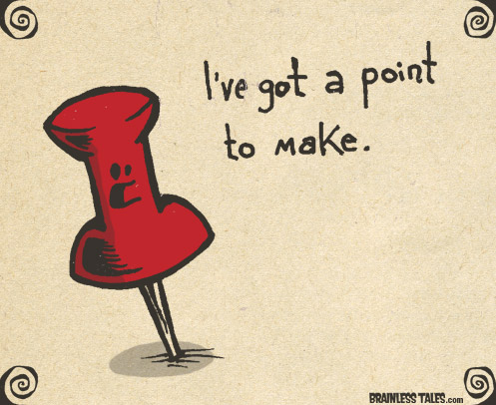
Explain what the quotation means, and how does it helps to establish the point you are making.

Slide 9
  The quote is NOT a substitute for your ideas.

Slide 10
2. Introduce the quote
Vary the verbs you use to introduce quotations. Some examples include:
  says informs us alleges
  writes claims states
  observes comments thinks
  notes affirms asserts
  remarks explains argues
  adds declares tells us
  points out insists finds

Slide 11
Author is neutral | Author implies/suggests | Author argues/claims | Author disagrees | Author agrees
comments | analyzes | contends | belittles | admits
describes | asks | defends | bemoans | agrees
explains | assesses | disagrees | complains | concedes
illustrates | concludes | holds | condemns | concurs
notes | finds | insists | deplores | grants
observes | predicts | maintains | deprecates
points out | proposes |  | derides
records | reveals |  | disparages
relates | shows |  | laments
reports | speculates |  | warns
says | suggests
sees | supposes
thinks
writes

Slide 12
Embedding Quotes
A more effective use of quotations is to embed a part of the sentence into your writing.

Slide 13
EXAMPLE
  Scout recognizes Walter’s hunger in his “red-rimmed and watery eyes” and his looking “as if he had been raised on fish food” (23).

Slide 14
Embedding Quotes
Use an ellipsis, three periods with spaces between them (…), within a quotation to show that part of the original text is left out.
An ellipsis at the beginning or end of a quotation is unnecessary.

Slide 15
EXAMPLE
“Mockingbirds don’t do one thing but make music for us to enjoy… they don’t do one thing but sing their hearts out for us” (75).

Slide 16
Embedding Quotes
Use single quotation marks around material that is already in quotations in the source you are quoting.
Single quotation marks are used only inside normal (double) quotation marks

Slide 17
EXAMPLE
  Harper Lee’s use of dialect adds to the character development. Jem’s age and almost brotherly concer show when he says to Dill, “ ‘she ain’t gonna get you. He’ll talk her out of it. That was fast thinkin’, son’ ” (55).

Slide 18
EXAMPLE
  Scout feels Jem’s emotion as she sees that his “shoulders jerked as if each ‘guilty’ was a separate stab between them” (211).

Slide 19
Embedding Quotes
Sometimes it is necessary to change the form of a word in a quotation (“walks” to “walked”) or to add a word of your own to make the sentence flow. Use brackets, [ ], to indicate anything you have changed.

Slide 20
EXAMPLE
  Regarding Mrs. Dubose, Atticus says to Jem that he “wanted [him] to see something about her” (112).

